Slide 1
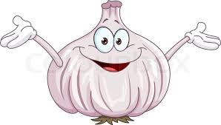
Garlic Curiosities
And some useful advise of sorts…

Slide 2
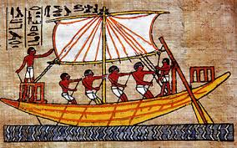
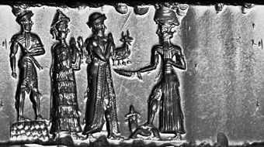
Origins
Dating back to the Babylonians some 4500 years ago, Garlic is one of oldest known horticultural crops in the Old World.

Slide 3
Historical Insights
Garlic has long been celebrated for its medicinal qualities.
Greeks consumed it before sports.
Vikings praised garlic for it’s spiritual purposes.
Romans consumed it before battle.
Egyptian slaves lived off it with bread whilst building the pyramids.
Asian countries prescribed it to lift depression and tx parasites.

Slide 4
Soft Neck

Slide 5
Hard Neck

Slide 6
Soft Neck | Hard Neck
Pliable stalk | Stiff central stalk
Falls over when ready for harvest | Harvest when top few leaves yellowing
Typically planted in early spring | Typically planted in autumn, over wintered
Stores better | More cold torrent
Commonly found in stores / grown for supermarkets. | More varieties
 | Produces scapes

Slide 7
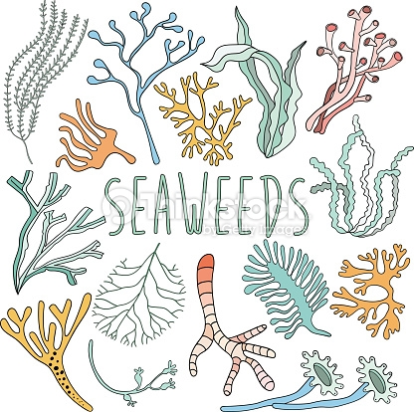
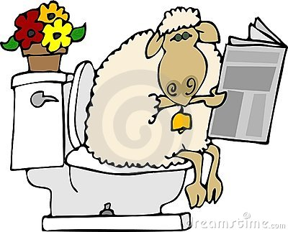
Growing
Must haves:
Good drainage – prefers semi dry growing conditions
Rich soil
Feed well – balanced NPK fertiliser or equivalent
Requires 6-8 hours sunlight / day
Ideal growing temps 13-23 degrees
Moderate to low water intake – keep irrigation as regular as possible
Minimal pest and disease – rust most common
Put some effort into bed preparation for a good harvest. Compressed sheep pellets work well, slow to break down, sustainable, cheep. Seaweed provides a good source of trace elements, also cheep if not free!

Slide 8
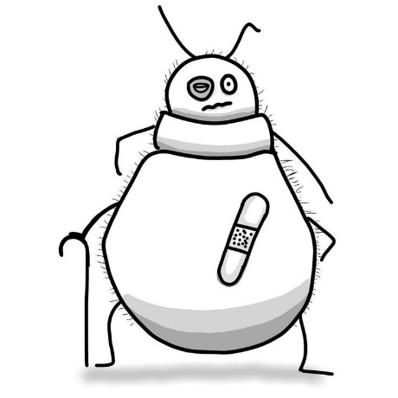
Growing…
Don’t separate the cloves from bub until ready to plant, this prevents the baby root drying out.
Keep weed free, well mulched.
Spaced about 10/15cm.
Companion with everything aside from: Peas, Beans, Cabbage, Strawberries. Excellent under apple trees, with roses, tomatoes, etc. Aphids HATE it.

Slide 9
Growing…..
Seed source
Resist the urge in using supermarket brought garlic. Often tx with fungicides, anyone's guess to what variety or origin?? In some cases plants will sprout, grow slightly but never form a decent bulb, waste of time. Instead save your own, Garlic will adapt to your growing environment therefore only improving your chances. Failing that, Framers market, garden centres, etc.
Scapes (flower stem) – remove approx. one month prior to harvest & eat YUM! Removing concentrates growth energy to bulb.

Slide 10
Harvest
STOP watering / irrigation one month out. Be sure to inform the weather of this requirement.
Aim for fine weather, no rain. Monitor long range weather forecasts in the lead up to Xmas / Jan.
Retain roots, shake off as mush soil as possible.
Once pulled lay out in sun for 1-2 days. Do so in order to cover the bulbs with leaf of next row. Fresh bulbs can and do get sun burnt
Hang, individually or bunches.
When dry, tidy up – remove soils, cut stems, inspect for any damage and discard, store in dry cool spot, check regularly. I use onion sacks hung in a cupboard.
Drying / Hanging area ideally dry, good air flow, out of direct sun, tin sheds no good.

Slide 11
How did the hipster burn his mouth?
He ate garlic bread long before it was cool……

